Slide 1

E-commerce cancellation Analysis
Pallavi saini

Slide 2
AIM
TO REDUCE THE ORDER CANCELLATION

Slide 3
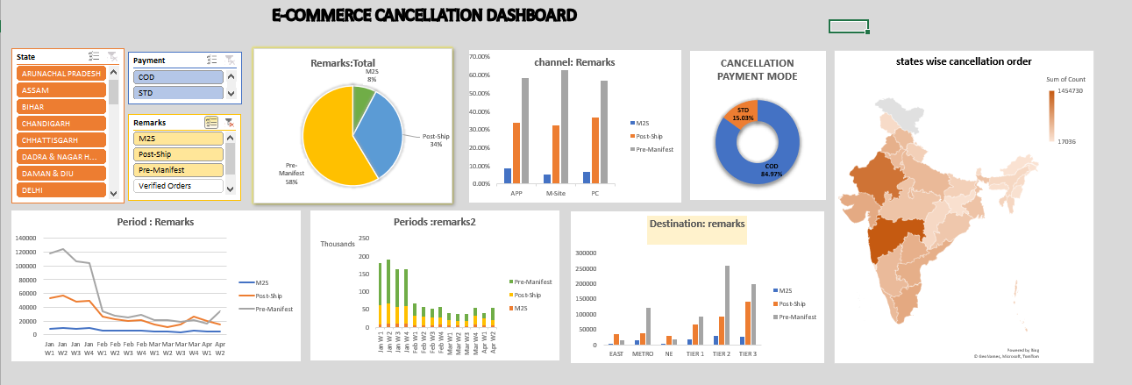
DASHBOARD

Slide 4
INSIGHT
UTTARAKHAND
Tier 3 residents of Uttarakhand may have a higher cancellation rate in January at post ship stage.

Slide 5
PROBLEM
Due to weather conditions and Infrastructure Challenges
January in Uttarakhand can experience harsh winter weather conditions, including heavy snowfall and cold temperatures & may have limited infrastructure compared to urban areas, which could affect the efficiency of logistics and transportation networks.

Slide 6
SOLUTION
Enhance logistics planning to mitigate the impact of weather-related disruptions on delivery schedule & Invest in improving infrastructure in Tier 3 regions, such as upgrading transportation networks and storage facilities, to enhance the efficiency of the supply chain and reduce delivery lead times in post shipment stage.

Slide 7
THANKYOU

